Slide 1
Metagenomic Comparison between the Gut Microbiota of Yellow Fever Mosquitos
(Aedes Aegypti)
Uyen Hoang
Ngoc Lu
Fabiola Briseno
Dang Minh Nhu Nguyen
Dr. Wendy Lee
Notes:
Ngoc

Slide 2
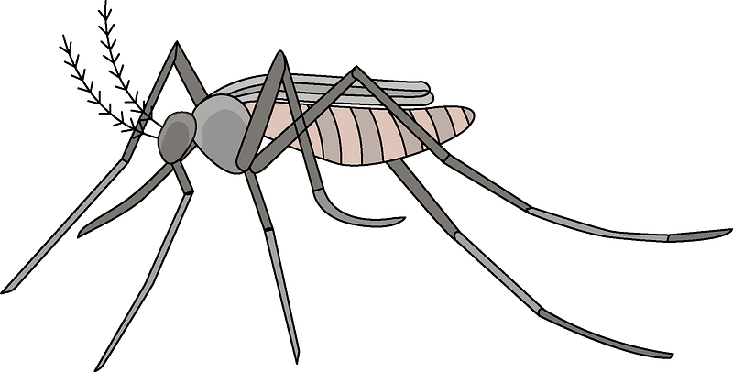
Why Aedes aegypti?
More than 700,000 people die from mosquito-borne diseases and millions are infected every year.(World Health Organization, 2020)
There is no medicine to treat or cure infection. (CDC)
A female Aedes aegypti mosquito often take up several blood meals before laying eggs, making it an effective biological vector.
Gut microbiota compositions has complicated effects on parasite infection.
Notes:
According to World Health Organization, 2020, more than 700,000 people die from mosquito-borne diseases and millions are infected every year. Yellow fever infection diagnosis is based on laboratory testing and patients’ symptoms. Although there is no effective treatment for blood-borne diseases, there is a safe and affordable vaccine available to combat the Yellow fever virus. But why do we focus on this particular mosquito species? It’s because they’re one of the most effective biological vector for virus transmission since one Aedes aegypti female mosquito often take up several blood meal before laying eggs. Also, their midgut can either prevent or promote parasite infection. So, focusing on gut bacterial communities can be a good strategy for controlling vector-borne diseases

Slide 3
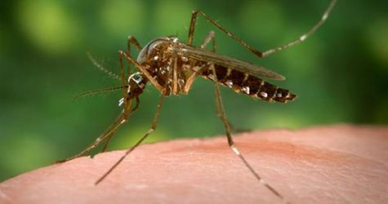
How does Yellow Fever affect to human body?
Mild symptoms
1 out of 7
Fever, Chills, Severe headache, Nausea, Vomiting, Weakness…
Initial symptoms
30-60%
Severe symptoms
Die
Yellow skin (Jaundice), bleeding, Shock and Organ failure
Notes:
Yellow fever patients often start with mild symptoms such as: fever, headache, muscle pain, nausea, vomiting and fatigue. 1 out 7 patients will enter the second phase with more severe symptoms such as: organ failure, or internal and external bleeding from mouth, nose, eyes. The death rate is 30-60% for patients who entered this second stage.

Slide 4
GOALS
Obtaining data from NCBI (SRA Bioproject PRJNA494958) .
Using Galaxy to align and compare genomes.
Analyse the result and use the data obtained to build a Krona Pie Chart.
Identifying the similarities and differences between the gut microbiota of Yellow Fever Mosquitos.
Visualize results in a Krona Pie Chart.
Notes:
So, investigating the mosquito midgut microbiome allows us to reduce the transmission of blood-borne pathogens. For this project, we will obtain data from the NCBI website. Then we’ll use Galaxy to align and compare bacterial genomes. Next, we will analyse the result and use the data obtained to build a Krona Pie Chart. After that, we identify the similarities and differences and differences between the gut microbiota of Yellow Fever Mosquitos. Finally, we will visualize results in a Krona Pie Chart.

Slide 5
• Hypothesis•
We hypothesize that the mosquitos with the most similar dietary restrictions will have the highest similarity in microorganism composition in their digestive tracts. We propose that this is due to only certain microorganisms being able to thrive in the digestive tracts when certain food sources are available.
Notes:
Ngoc

Slide 6
Materials and Methods
Notes:
Fabi

Slide 7
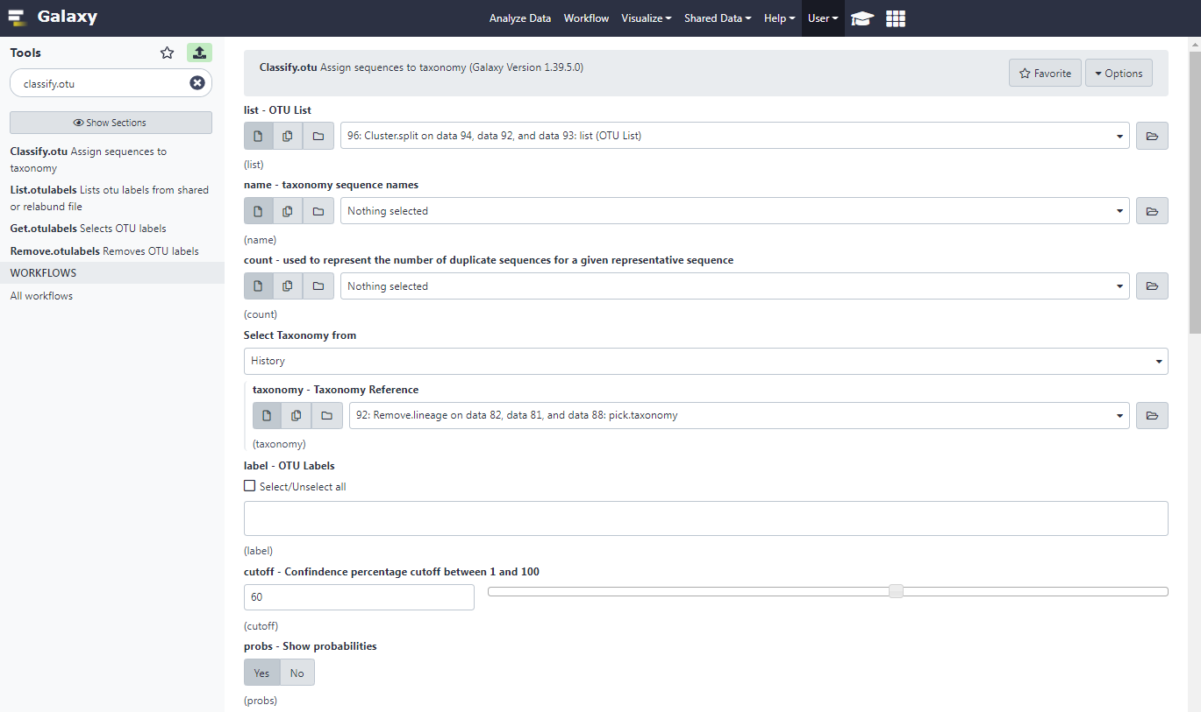
• Materials
Reference Genome: Silva Database Version 123.
Available to download at (http://arb-silva.de).
SSR Accession Lists for the following experimental diets: Unfed, Sugar Fed, Rabbit Fed, Human Fed, Chicken Fed.
The data is available at NCBI SRA Bioproject PRJNA541017.
Galaxy Bioinformatics Analysis Platform (https://usegalaxy.org/)
Taxonomy Data Files: obtained from the “BIOL/CS123B Metagenomics Data Analysis” website created by Dr. Wendy Lee and Dr. Cleber Ouverney (2020).
https://raw.githubusercontent.com/csbfx/micro101/main/trainset9_032012.pds.fasta
https://raw.githubusercontent.com/csbfx/micro101/main/trainset9_032012.pds.tax
Notes:
Fabiola
In order to examine the effect of food sources on the composition of microorganisms within the Yellow Fever mosquitos’ midgut, we used data from a study performed by Frankel-Bricker J. and Frankel L. K [1]. In their study, the scientists collected adult mosquitos (Gainesiville strain) immediately after hatching from pupaes and extracted their microbial RNA samples. They utilized five different experimental conditions to perform their analysis: samples from yellow fever mosquitos that were raised with human blood, sugar, chicken blood, rabbit blood, and mosquitos that had been unfed as a negative control. They obtained a total of 148 samples that were sequenced by an Illumina MiSeq instrument using paired-end sequencing. This data is publicly available in the NCBI SRA Bioproject PRJNA541017.
Frankel-Bricker et al. also designed sequence specific primers to amplify the 16s V3-V4 region. As a result, our analysis needed to similarly target the 16S V3-V4 region by utilizing a reliable reference alignment file. After reading a study by Bukin, Y.S. et al, we selected the Silva.123 database which was released on July 23, 2015 as it was similarly used by the scientists to align their RNA samples [2]. The Silva.123 was downloaded from the SILVA 123 online database (http://arb-silva.de).
Furthermore, to perform taxonomic classification of our sequences, we also required two taxonomy data files which we obtained from the “BIOL/CS123B Metagenomics Data Analysis” website created by Wendy Lee and Cleber Ouverney [3].

Slide 8
• Materials
Feeding Condition | SRA Accession Numbers
Sugar | SRR7975705, SRR7975706, SRR7975707, SRR7975708, SRR7975709, SRR7975710, SRR7975711, SRR7975712, SRR7975713, SRR7975714
Unfed | SRR7975717, SRR7975718, SRR7975723, SRR7975724, SRR7975725, SRR7975726, SRR7975727, SRR7975728, SRR7975729, SRR7975730
Rabbit Blood | SRR7975732, SRR7975733, SRR7975734, SRR7975735, SRR7975736
Chicken Blood | SRR7975695, SRR7975696, SRR7975697, SRR7975698, SRR7975699
Human Blood | SRR7975758, SRR7975788, SRR7975789, SRR7975791, SRR7975792
Table 1: Table depicting the SRA accession numbers used in the metagenomic analyses. While the Sugar and Unfed conditions analyzed 10 samples, Rabbit Chicken and Human blood conditions analyzed 5 samples each.
Notes:
Fabiola
Rather than performing the analysis on all 148 samples from the Frankel-Bricker study, we performed separate metagenomic analyses using between 5-10 random samples from each condition, as seen in Table 1. This was purposely done because when attempting to perform the metagenomic analysis on all 148 samples, we continuously ran out of space on our Galaxy servers. By reducing the number of samples we analyzed, we were able to perform all five separate metagenomic analyses in order to effectively compare the composition of microorganisms within the Yellow Fever mosquitos’ digestive tracts when raised on different food sources.
2.5 minutes total

Slide 9
• Methods
02
03
04
01
Sequencing Alignment
Data Quality Control
Sequence Alignment:
Align.seqs
Summary.seqs
Data Cleaning:
Screen.Seqs
Filter.seqs
Unique.Seqs
Pre-clustering
Chimera removal
Chimera.vsearch
Remove.seqs
Make.Contigs
Summary.Seqs
Screen.Seqs
Unique.Seqs
Count.seqs
Taxonomic Classification
Obtain and Prepare 16s rRNA Sequencing Data
1. Classify.seqs
2. Remove.lineages
Notes:
UYEN: HERE THE SUMMARY OF STEP WE TOOK TO GET THE RESULT
Step 1: First, we needed to build small databases using the Run selector from NCBI SRA. The database will consist of five 16S rRNA sequences list. EACH OF us in our group will run the analysis on the galaxy We adapted our protocol from the “BIOL/CS123B Metagenomics Data Analysis” by DR Wendy Lee and Cleber Ouverney (2020) to identify the similarities between the gut microbiota of Yellow Fever Mosquitos by building a Krona Pie Chart using Galaxy.
After We get the list , we utilized the Run Selector Feature on the NCBI SRA website and uploaded our data to galaxy and run Faster Download and Extract Reads in FastQC tool
Step 2:
DATA QUALITY CONTROL
Make.Contigs: Use the Paired-End Data (fasterq-dump) obtained Step 1which will combine the forward and reverse reads for each sample, and also combine the resulting contigs from all samples into a single file.
Summary.Seqs to clean the sequences and return information per read.
Screen.Seqs filter based on quality and length
Specifically, this cleaning tool will remove sequences with ambiguous bases (maxambig) and contigs longer than a given threshold (maxlength). parameter
Unique.Seqs to remove duplicate sequences
Count.seqs to count the number of sequences
Step 3:upload the reference genmone from silva
Pre.cluster to get near-identical sequences into one sequence.
Another important step is remove a class of sequencing artifacts known as chimeras, which occurs when the polymerase falls off one sequence and then reattaches to another during a single round of PCR.
This results in a seemingly unique sequence, but is, in fact, two different sequences merged together.
Chimera removal will be performed using the VSEARCH algorithm within mothur
this only stores the chimeric sequences in a count table file, so we will need to physically remove them from the fasta file using Remove.seqs. tool

Slide 10
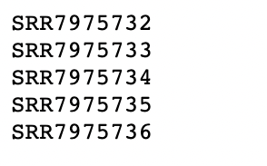
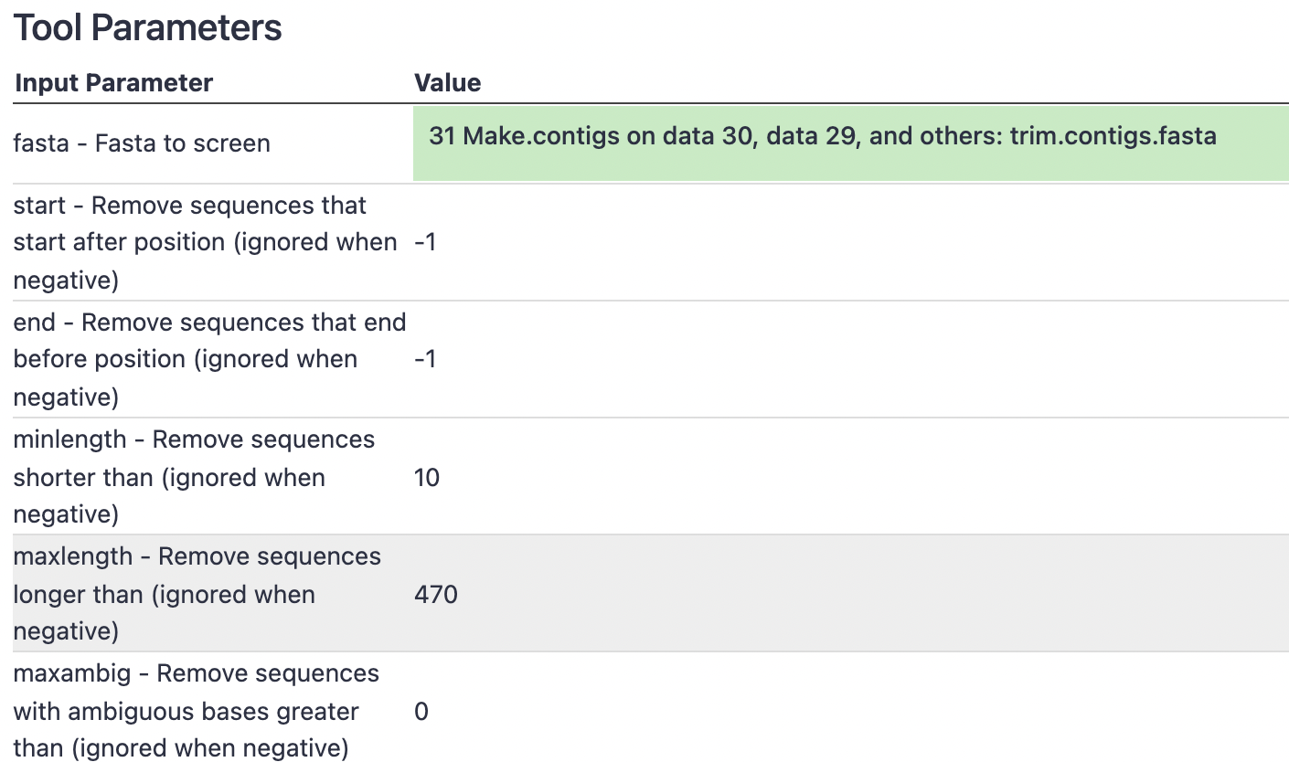
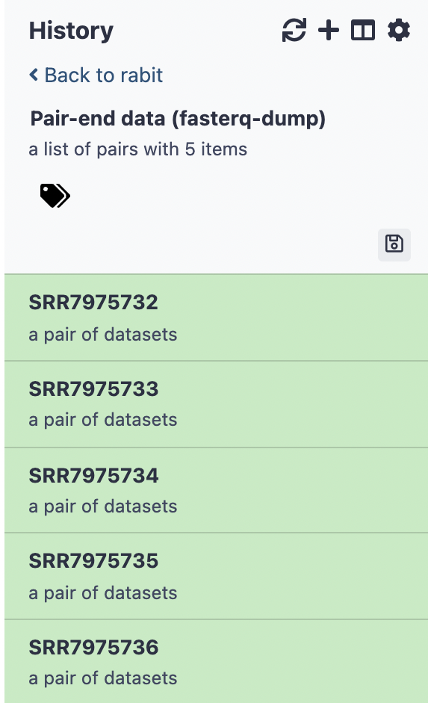
• Methods
Obtain and Prepare 16s rRNA Sequencing Data
Data Quality Control
Notes:
Uyen: Protocol adapted from the “BIOL/CS123B Metagenomics Data Analysis” by Wendy Lee and Cleber Ouverney (2020).
Faster Download and Extract Reads
Since target the 16S V3-V4 region is about 443 base pairs, we will be using the maxlength as “470” and maxambig as “0”.

Slide 11
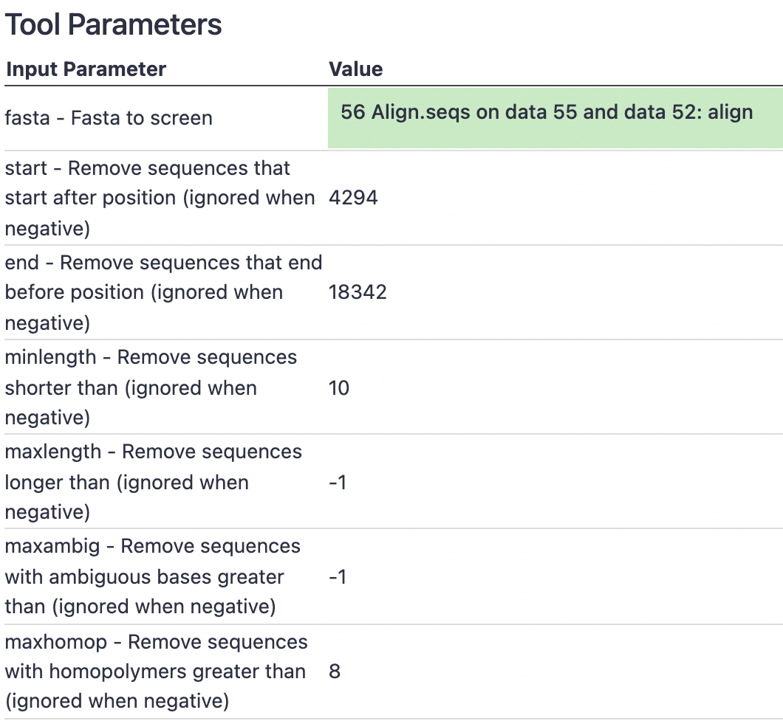
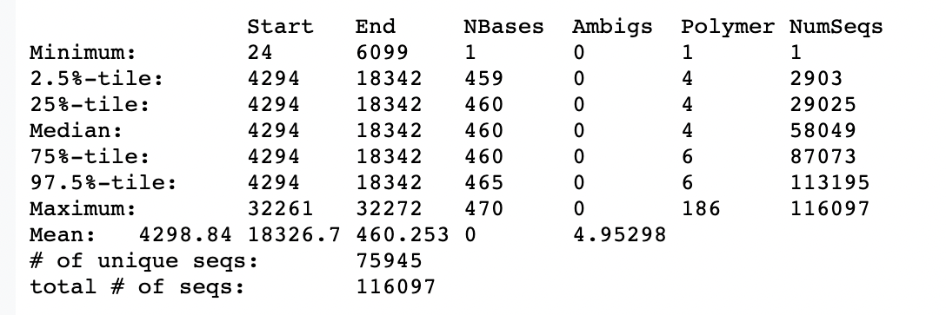
• Methods
Sequencing Alignment
Reference data files Silva Database Version 123 (https://www.arb-silva.de/documentation/release-123/)
Summary.seqs for Rabbit samples
Screen.Seqs for Rabbit samples
Notes:
As a result, our analysis needed to similarly target the 16S V3-V4 region by utilizing a reliable reference alignment file.
ensure all our reads overlap our region of interest, . This step will remove any reads not overlapping the region region and any overhang sequences

Slide 12
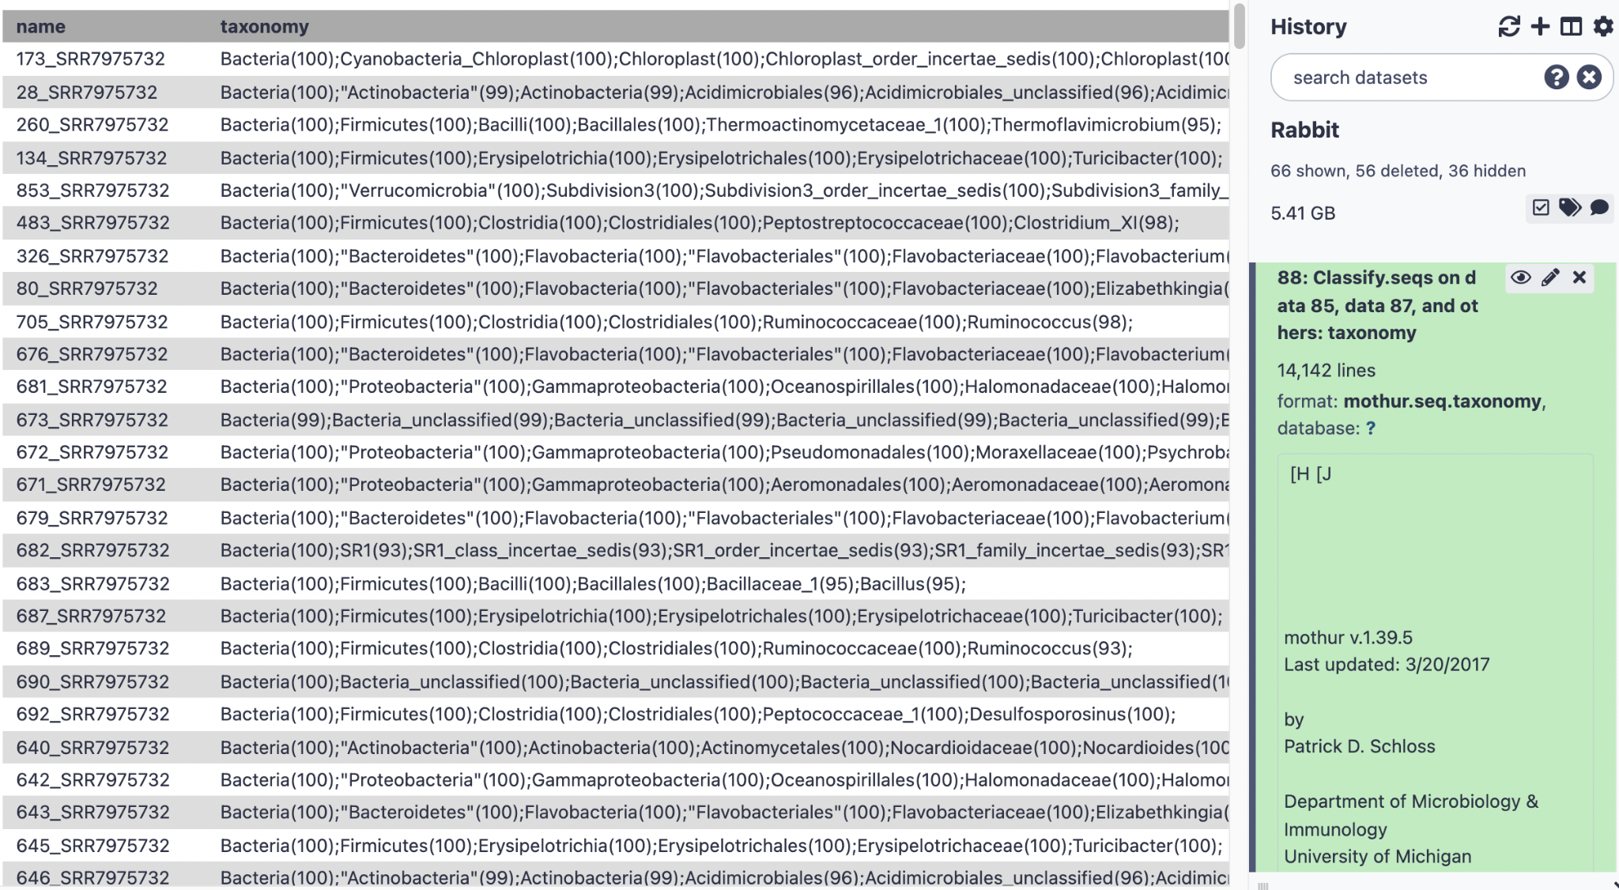
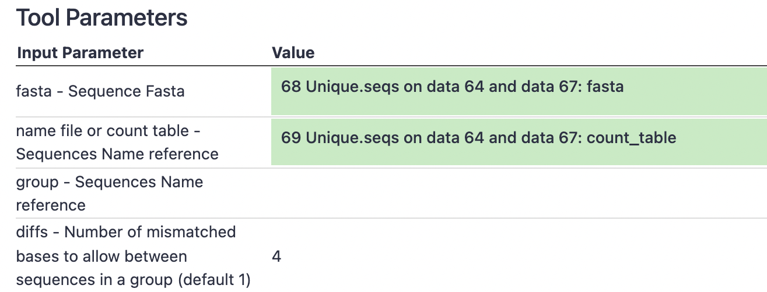
• Methods
Pre.clustering for Rabbit samples
Classify.seqs for Rabbit samples
Notes:
Pre.cluster to join near-identical sequences into one sequence. Because our contigs are ~442 bp long, we will set the threshold to “4” mismatches and homopolymer to “8”. Since we know that our reference database does not contain any homopolymer stretches longer than 8 bases, any reads containing such long stretches are likely the result of technical errors in the lab.
The picture from taxonomy classification step

Slide 13
• Methods
07
05
06
Analyze Results
OTU Clustering
Cluster.split
Make.shared
Classify.otu
Count.group
Sub.sample
KRONA Visualization
Taxonomy-to-Krona
Krona pie chart
Notes:
Nhu:and the next step is OTU Clustering, Cluster.split is the tool used to perform clustering apply a 0.03 cutoff with taxlevel set to 4. Next, we need to know how many sequences in each of OTU and this is achieved by Make.shared tool. Then we differentiate each of the taxonomy by Classify.otu. Normalization of the data set is an essential step for data analysis, so our data needs to be subsampled by count.group and sub.samples. The last step is visualizing the composition of our data using Krona. The resulting file will contain an interactive Krona pie chart that helps us compare results for each type of sample. The last step is analyzing the result and state our conclusions.

Slide 14
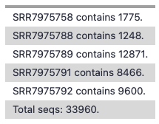
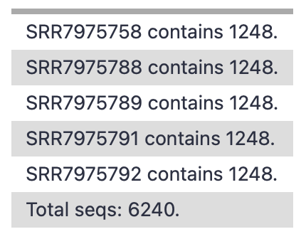
• Methods
Identifying smallest sample at Count.groups (Human Blood sample)
Run Count.groups again with the share file from Sub.sample
(Human Blood sample)
Notes:
Nhu: This is an example of Human Blood analysis at the Count.groups step when doing OTU Clustering, we are able to identify the smallest sample is contains 1248 sequences which is our size to use in Sub.sample tool. And after running the Count.groups again on the shared output by Sub.sample, the result is as expected.

Slide 15
Results
Notes:
Fabiola:
As previously stated, to elucidate the effect of different food sources on the composition of microorganisms within the mosquito’s digestive tracts, we ran five separate 16S metagenomic analyses which generated 5 Krona Pie Charts for each feeding condition. We found that the main core bacterial phyla between the five conditions were Bacteroidetes and Proteobacteria, which accounted for 49% - 96% of the gut microorganism populations which will be depicted on the following slides.

Slide 16
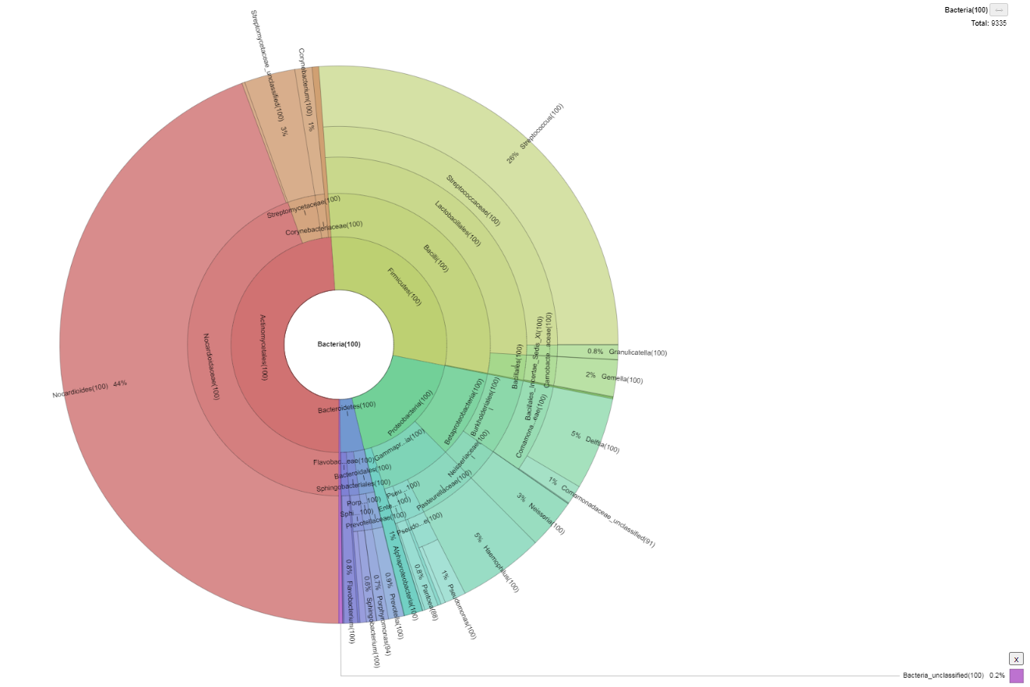
• Results - Unfed
49%
29%
18%
Actinomycetales
i.e. Nocardioides
Firmicutes
i.e Streptococcus, Lactobacillus
Proteobacteria
i.e. Neisseria
Notes:
Fabiola:
We found that the mosquitoes that had gone unfed had 49% of its bacterial gut population composed of Actinomycetes which are group of immobile bacteria found in a variety of environments and share similarities with fungi.
We also found these mosquitos having 29% of Firmicutes, which are a group of bacteria that are commonly found in the human gut, and 18% proteobacteria, which is another type of bacterial phyla that are normally found in the human gut and include a wide variety of pathogens.
The remaining 4% belonged to Bacteroidetes, which includes Flavobacterium.

Slide 17
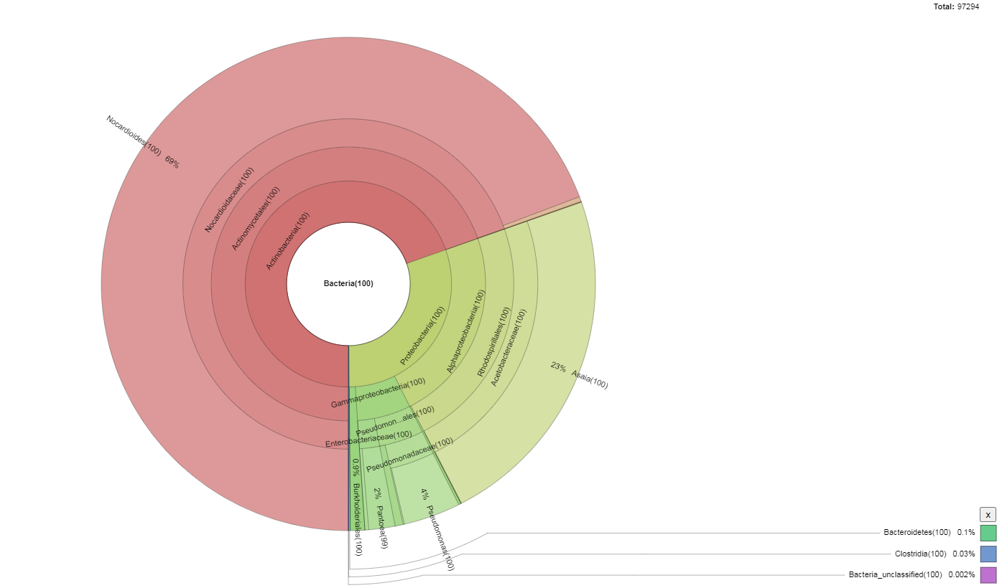
• Results - Sugar
70%
30%
<0.5%
Actinobacteria
i.e. Nocardioides
Proteobacteria
i.e Gammaproteobacteria, Asaia
Clostridia and Bacteroidetes
Notes:
Fabiola:
Sugar-fed mosquitos had 70% of its gut bacterial composition belonging to Actinobacteria, specifically Nocardioides. As mentioned earlier, Actinomycetes belong to the order of Actinobacteria and these bacteria are mainly involved in decomposing and degrading organic material. These mosquitoes also exhibited a significant portion of its bacterial gut composition belonging to Proteobacteria at 30%, and less than 0.5% composed of Clostridia and Bacteroidetes. Clostridia and bacteroidetes are both normally found in human digestive tracts and facilitate the digestion of complex carbohydrates that our body cannot break down.
In comparison to the following Krona pie charts, the Sugar-fed and unfed mosquitos had the highest amount of bacterial diversity which is exemplified by the wider distribution of colors and segments in the pie chart.

Slide 18
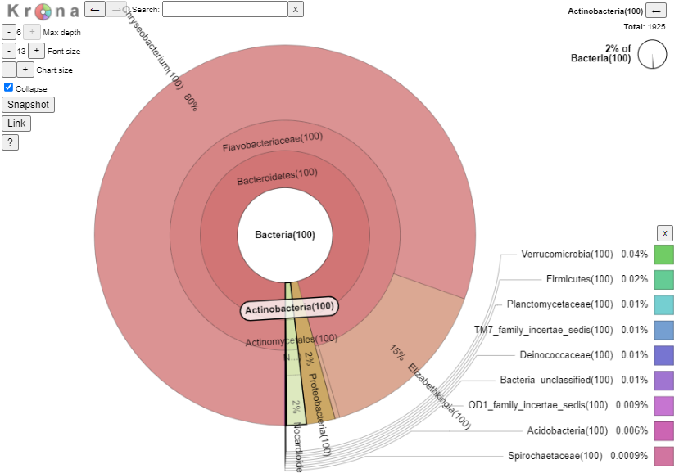
• Results - Chicken Blood
96%
2%
2%
Bacteroidetes
i.e.Chryseobacterium, Elizabethkingia
Proteobacteria
Actinobacteria
i.e Firmicutes
Notes:
Fabiola
Particularly, mosquitos raised on chicken blood exhibited the least bacterial diversity with 96% of its gut bacterial population belonging to the Bacteroidetes Phylum, specifically Chryseobacterium and Elizabethkingia.
The remaining 4% of the bacterial composition in these mosquitoes belonged to Proteobacteria (2%) and Actinobacteria (2%).
%

Slide 19
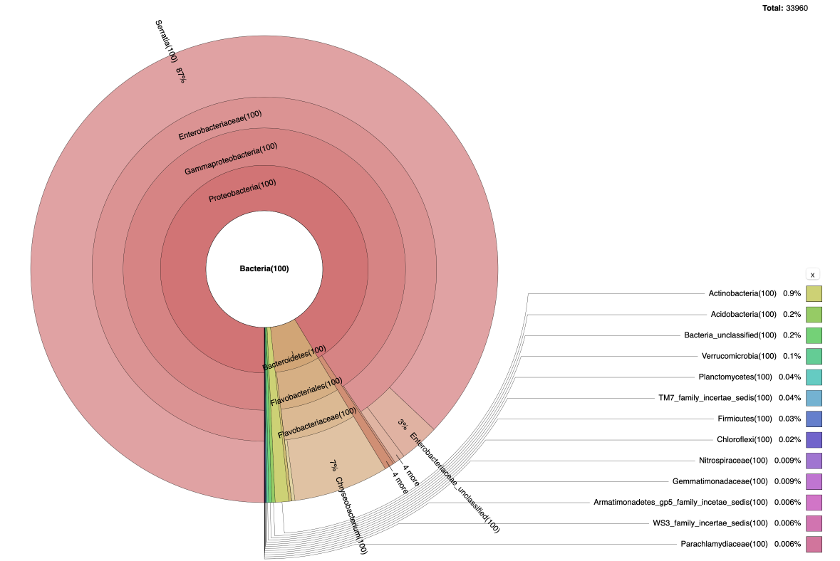
• Results - Human Blood
91%
7%
2%
Proteobacteria
i.e. Serratia
Bacteroidetes
i.e. Flavobacteriales,
Flavobacteriaceae, Chryseobacterium
Others
i.e. Actinobacteria, Acidobacteria
Notes:
Fabi
Similarly, we found that mosquitos raised on human blood also had low bacterial diversity, but not as low as the mosquitoes raised on chicken blood. The mosquitos raised on human blood had 91% of its gut bacterial population composed of Proteobacteria, specifically Serratia, which belongs to the Chryseobacterium genus.
The other two significant groups that composed these mosquitos’ gut bacterial population were Bacteroidetes (7%) and others (2%), which included Actinobacteria and Acidobacteria.

Slide 20
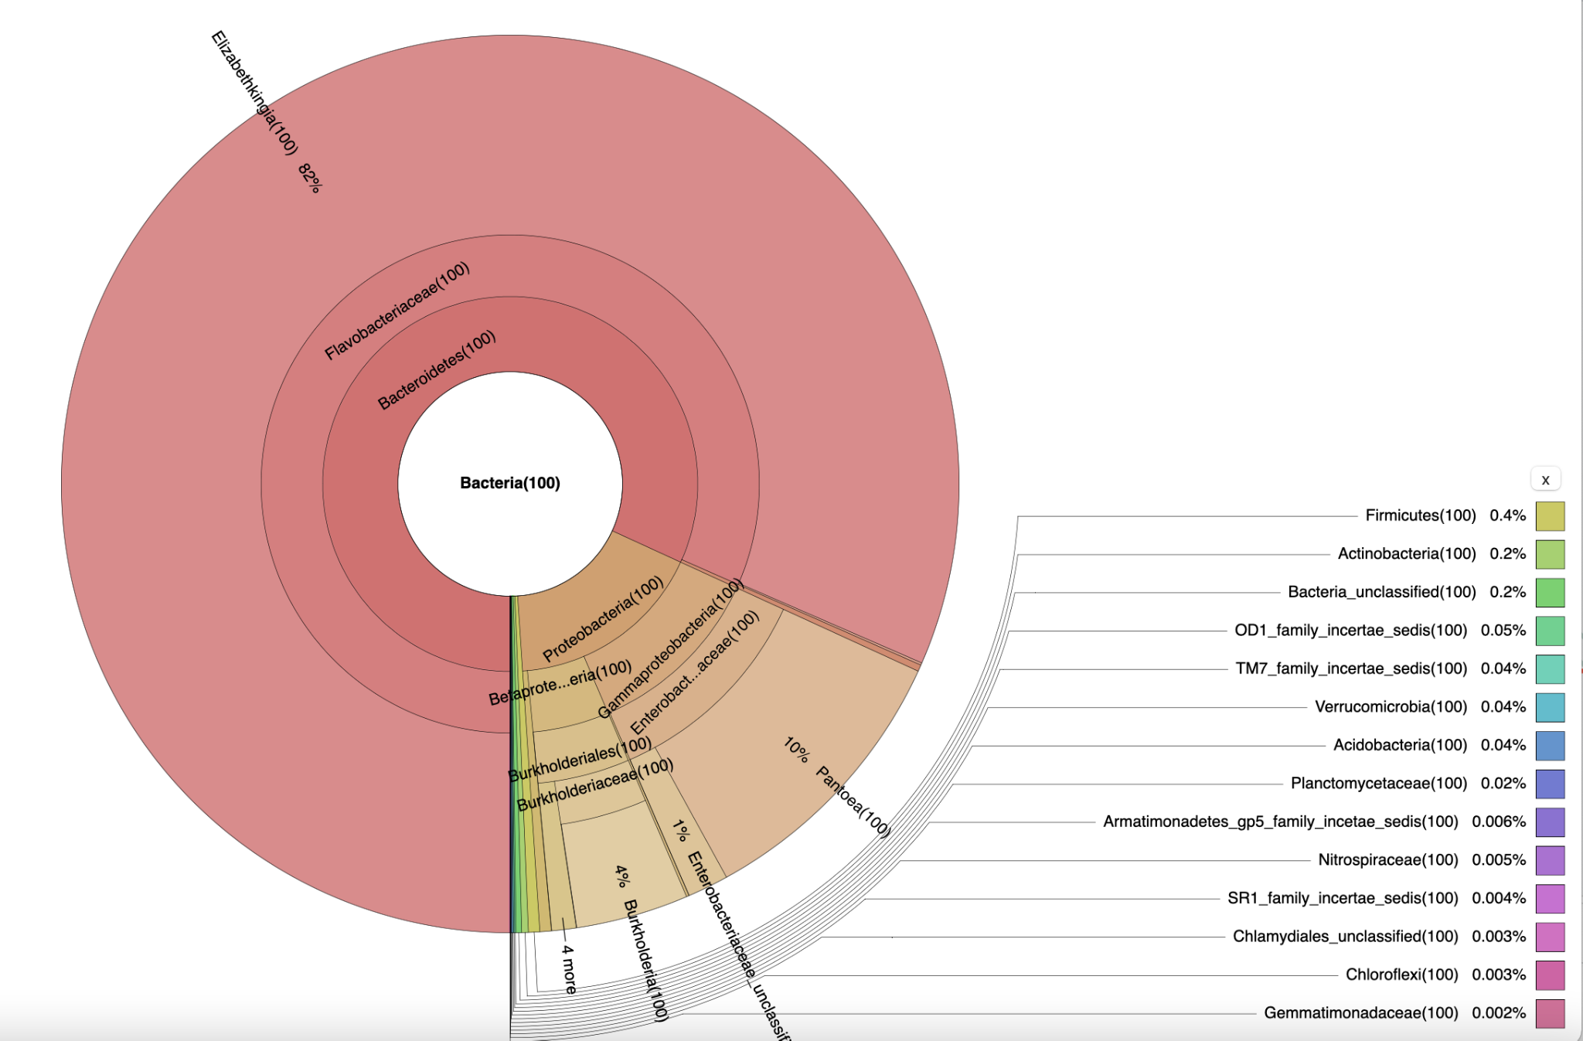
• Results - Rabbit Blood
82%
17%
1%
Bacteroidetes
i.e. Elizabethkingia
Proteobacteria
i.e. Gammaproteobacteria
Others
i.e Pantoea, Enterobacteriaceae
Notes:
Fabiola
Mosquitos raised on rabbit blood had 82% of its bacterial gut population composed of Bacteroidetes, specifically Elizabethkingia. These mosquitoes also had 17% of its bacterial gut diversity belonging to Proteobacteria and 1% of others, including Pantoea and Enterobacteriaceae.

Slide 21
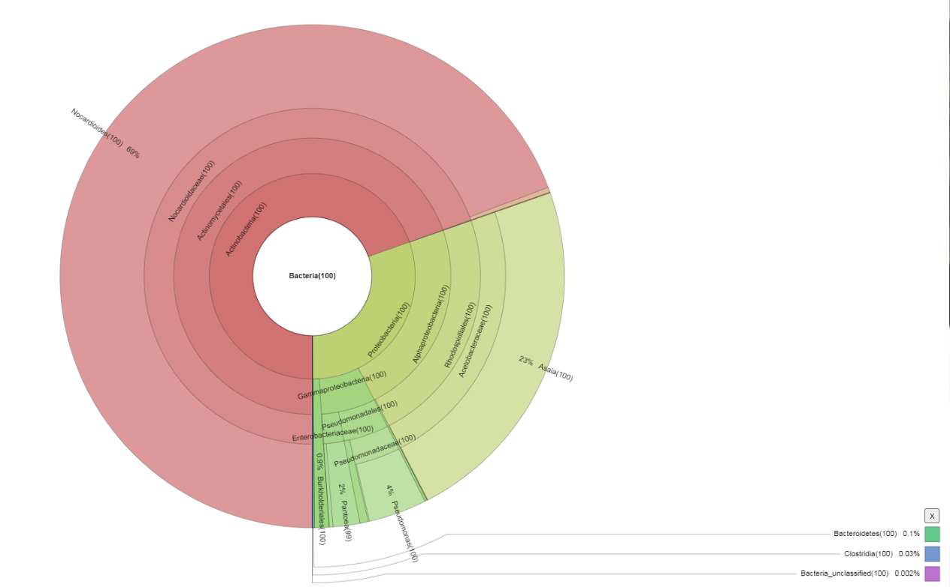
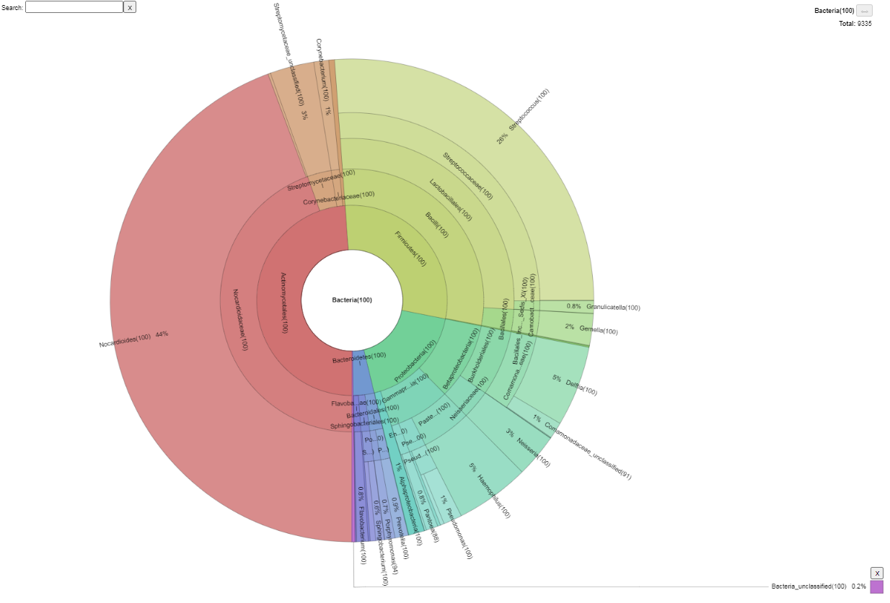
Analysis: Similarities and Differences
Sugar
Unfed
Human
Chicken
Rabbit
Notes:
Nhu: To determine whether we can accept or reject our hypothesis, we needed to draw a comparison between our results. Most notably, the mosquitoes fed with chicken and rabbit blood both had Bacteroidetes as the majority of the bacterial gut composition which supported our hypothesis. Also, these two mosquito populations had Proteobacteria as their second most type of bacteria.
The majority of the gut bacterial in Human Blood sample composition was Proteobacteria while in the chicken and rabbit blood fed was Bacteroidetes. In the human blood fed mosquitoes, Bacteroidetes was only 7% of its gut bacterial composition, opposite to the other blood fed mosquitoes. Furthermore, the differences between non-blood fed mosquitoes and blood fed mosquitoes also supported our results. In the Sugar-fed and unfed mosquitoes, we see a wider diversity of bacterial organisms, but in the blood-fed mosquitoes, we mainly observe a single type of bacteria being more abundant than the rest.
In the Sugar-fed and unfed mosquitoes, the most abundant bacteria are Actinobacteria and Ac ti no my cetales which we couldn’t see in the blood-fed mosquitoes. In the unfed mosquitos, we see Firm icutes present in the mosquitos’ guts which is strikingly similar to the bacteria present in human digestive tracts. However, the presence of Firm icutes are greatly reduced when the mosquitoes are fed with sugar.
So, our results lead us to accept our hypothesis
that the mosquitos with the most similar dietary restrictions will have the highest similarity in microorganism composition in their digestive tracts.

Slide 22
• Discussion
The midgut microbial communities’ diversity can be strongly influenced by both genetic and environmental factors.
Mosquitoes fed on carbohydrate-rich sugar possess a different microbiota composition compared to those fed on protein-rich blood. “Core” taxa:
Chicken and rabbit blood fed: Chryseobacterium
Sugar fed and unfed: Actinobacteria
Human-blood fed: Proteobacteria
Most likely to be infected by blood-borne pathogens
Limitation: small sample sizes.
Notes:
Ngoc: The midgut’s microbial communities support many crucial functions for the host, and their diversity can be strongly influenced by both genetic and environmental factors. And in this project we investigate how different food sources alter the composition of bacterial communities in the Aedes Aegypti mosquitoes. We found that mosquitoes fed on carbohydrate-rich sugar possess a different microbiota composition compared to those fed on protein-rich blood. Specifically, the core taxa found in chicken and rabbit blood fed mosquitoes is …….. For human blood fed is proteobacteria. Importantly, proteobacteria was found to have high contribution on viral infection in mosquitoes. This explain why humans are the most likely to be infected by blood-borne pathogens. However, our analysis holds some limitations. So, due to limited data storage, only 10 SRAs sequences were run for sugar, and unfed samples; 5 sequences were run for chicken fed, rabbit fed, and human fed samples. Since our sample sizes were small, our results might not present a comprehensive relationship between the microbial communities.
Youre gonna have to go fast were out of time:(((

Slide 23
References:
[1]World Health Organization. (n.d.). Vector-borne diseases. World Health Organization. Retrieved November 30, 2021, from https://www.who.int/news-room/fact-sheets/detail/vector-borne-diseases.
[2]Barletta, A. B., Nascimento-Silva, M. C., Talyuli, O. A., Oliveira, J. H., Pereira, L. O., Oliveira, P. L., & Sorgine, M. H. (2017). Microbiota activates the IMD pathway and limits Sindbis infection in Aedes aegypti. Parasites & vectors, 10(1), 103. https://doi.org/10.1186/s13071-017-2040-9
[3] Huang, W. (2020). Use of Microbiota to Fight Mosquito-Borne Disease. Frontiers. https://www.frontiersin.org/articles/10.3389/fgene.2020.00196/full
[4] Bando H., Okado K., Guelbeogo W. M., Badolo A., Aonuma H., Nelson B., et al. . (2013). Intra-specific diversity of Serratia marcescens in Anopheles mosquito midgut defines Plasmodium transmission capacity. Sci. Rep. 3:1641. 10.1038/srep01641
[5] Frankel-Bricker, J. (2021, April 2). Re-Analysis of 16S rRNA Gene Sequence Data Sets Uncovers Disparate Laboratory-Specific Microbiomes Associated with the Yellow Fever Mosquito (Aedes aegypti). Microbial Ecology. https://link.springer.com/article/10.1007/s00248-021-01739-2?error=cookies_not_supported&code=26503f03-e2ec-43f6-865a-05fb592a649e
[6] Bukin, Y., Galachyants, Y., Morozov, I. et al. The effect of 16S rRNA region choice on bacterial community metabarcoding results. Sci Data 6, 190007 (2019). https://doi.org/10.1038/sdata.2019.7
[7] Lee, W. (2020). METAGENOMICS DATA ANALYSIS. Google Sites. Retrieved November 29, 2021, from https://sites.google.com/sjsu.edu/sjsu123b-metagenomics/home
[8] Huang, W., Wang, S., & Jacobs-Lorena, M. (2020). Use of Microbiota to Fight Mosquito-Borne Disease. Frontiers in Genetics, 11. https://doi.org/10.3389/fgene.2020.00196
[9] Ephantus J Muturi, Christopher Dunlap, Jose L Ramirez, Alejandro P Rooney, Chang-Hyun Kim, Host blood-meal source has a strong impact on gut microbiota of Aedes aegypti, FEMS Microbiology Ecology, Volume 95, Issue 1, January 2019, fiy213, https://doi.org/10.1093/femsec/fiy213
[10]Moreira, L. A., Iturbe-Ormaetxe, I., Jeffery, J. A., Lu, G., Pyke, A. T., Hedges, L. M., Rocha, B. C., Hall-Mendelin, S., Day, A., Riegler, M., Hugo, L. E., Johnson, K. N., Kay, B. H., McGraw, E. A., van den Hurk, A. F., Ryan, P. A., & O'Neill, S. L. (2009). A Wolbachia symbiont in Aedes aegypti limits infection with dengue, Chikungunya, and Plasmodium. Cell, 139(7), 1268–1278. https://doi.org/10.1016/j.cell.2009.11.042
[11] Yellow Fever. (2021). CDC.Gov. https://www.cdc.gov/yellowfever/index.html
Notes:
Uyen: here is the list of sources which are used to support our project

Slide 24
Thank you for listening!
Do you have any questions?
Notes:
Uyen

